Slide 1

Introduction to MLOps
YOUSSEF HAMED

Slide 2
  WHAT MLOPS IS
  WHY MLOPS EXISTS
  HOW IT DIFFERS FROM TRADITIONAL DEVOPS
  REAL REASONS ML PROJECTS FAIL IN PRODUCTION

Slide 3
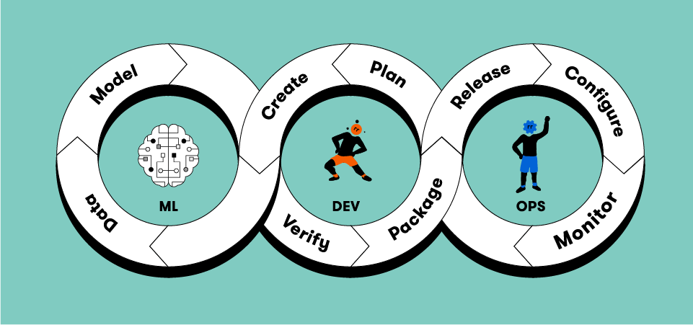
WHAT IS MLOPS ?
  DISCIPLINE FOR MANAGING DATA + CODE + MODELS
  AUTOMATES ML LIFECYCLE
  ENSURES REPRODUCIBILITY, SCALABILITY, RELIABILITY
  INSPIRED BY DEVOPS, BUT ADAPTED FOR ML NEEDS

Slide 4

MLOPS = DataOPS + DevOPS + ModelOPS
  RELIABLE DATA PIPELINES
  Data validatiON & QUALITY CHECKS
  FEATURE ENGINEERING AUTOMATION
  DATA VERSIONING (DVC, DELTA, ETC.)
  EXPERIMENT TRACKING
  MODEL REGISTRY & VERSION CONTROL
  DEPLOYMENT STRATEGIES (A/B, CANARY)
  MONITORING & RETRAINING
  CI/CD FOR ML CODE
  CONTAINERIZATION (DOCKER)
  INFRASTRUCTURE AUTOMATION (K8S)
  REPRODUCIBLE ENVIRONMENTS

Slide 5
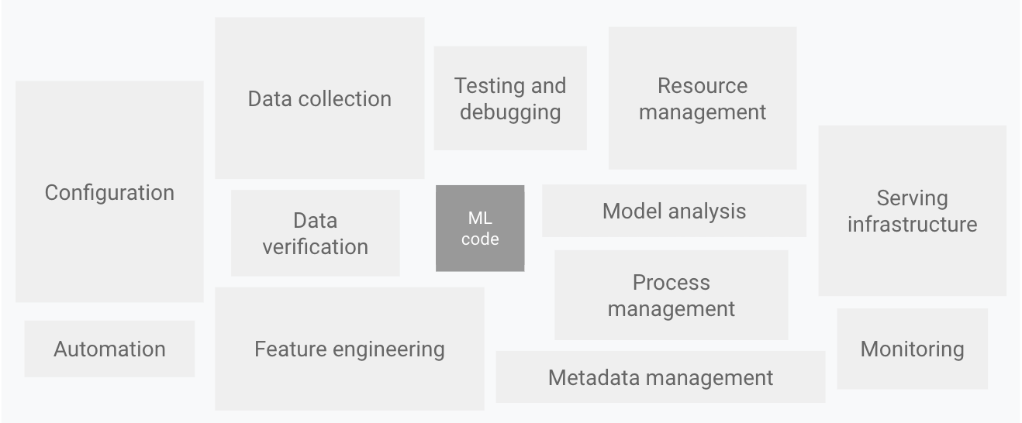

Slide 6



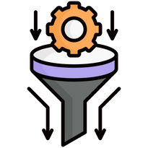
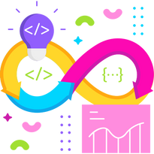


Why MLOps Exists
Model Decay
ML model lose accuray ﻿over time as real-world data change, leading to unreliable predictions.
Automated Monitoring
Continuously tracks model performance and triggers retraining when accuracy drops
Deployment bottleneck
Deploying ML models is slow and error-prone due to manual process.
CI/CD for Models
Automates Deployment pipelines, reducing errors and accelerating time to production.
Lack of collaboration
Data Scientists, engineers and business teams struggle to work together.
Version Control
ensures structured workflows, enabling teams to collaborate and tracks changes .

Slide 7
“We Have No Idea How Models will Behave in Production until Production”
REF
. DATA DISTRIBUTION SHIFTS
  TRAINING DATA ≠ REAL-WORLD DATA
  DATA DRIFT / CONCEPT DRIFT
  MODEL BECOMES IRRELEVANT OVER TIME
  EXAMPLE: SEASONAL PATTERNS, NEW FRAUD TYPES
LACK OF MONITORING
  NO TRACKING OF DRIFT OR PERFORMANCE
  MISSES DATA QUALITY ISSUES
  MISSES LATENCY/BUSINESS KPIS
  FAILURES DISCOVERED TOO LATE
ORGANIZATIONAL & HUMAN FACTORS
  POOR COLLABORATION DS ↔ ENGINEERING
  UNREALISTIC STAKEHOLDER EXPECTATIONS
  LACK OF INVESTMENT IN MONITORING & INFRA
  MATURITY GAP IN ML PROCESSES
OVERFITTING TO LAB DATA
  MODEL MEMORIZES TRAINING DATA
  POOR GENERALIZATION
  TEST SET TOO SIMILAR TO TRAINING
  LACK OF AUGMENTATION & DIVERSITY
METRICS NOT ALIGNED WITH BUSINESS GOALS
  OPTIMIZING ACCURACY INSTEAD OF VALUE
  HIGH PRECISION BUT LOW REVENUE IMPACT
  MISMATCH BETWEEN DATA METRICS AND KPIS
OVERFITTING TO LAB DATA
  MODEL MEMORIZES TRAINING DATA
  POOR GENERALIZATION
  TEST SET TOO SIMILAR TO TRAINING
  LACK OF AUGMENTATION & DIVERSITY
INTEGRATION & INFRASTRUCTURE ISSUES
  NOTEBOOK → PRODUCTION GAP
  LATENCY TOO HIGH FOR REAL-TIME
  HEAVY GPU/CPU REQUIREMENTS
  VERSIONING & DEPENDENCY CONFLICTS
UNHANDLED EDGE CASES
  REAL WORLD ≠ CLEAN DATASET
  UNSEEN SCENARIOS BREAK MODEL
  EXAMPLES: RARE OBJECTS, SLANG, NOISE
SECURITY & ADVERSARIAL ATTACKS
  MODELS EASILY FOOLED INTENTIONALLY
  SMALL PERTURBATIONS → WRONG OUTPUT
  NEEDS ROBUST DEFENSES
MODEL STALENESS
  USER BEHAVIOR CHANGES
  ENVIRONMENT EVOLVES
  NEEDS PERIODIC RETRAINING
  OUTDATED MODEL LOSES ACCURACY

Slide 8
DevOps vs MLOps
 | DevOps | MLOps
Team Roles | Software engineers with predictable workflows | Data scientists + ML engineers
Nature of Development | Deterministic — behavior changes only when code changes | Non-deterministic — model behavior depends on data, features, hyperparameters, environment
Testing Scope | Unit tests, integration tests, functional tests | Test code + data + model
Versioning Needs | Version code and configs | Version datasets, models, experiments, features
Deployment Unit | A software package/microservice | A whole ML pipeline
Production Behavior | Stable once deployed; failures come from code bugs | Models degrade over time due to data drift
Operational Monitoring | System metrics (CPU, RAM, uptime, logs) | Model metrics + data quality + drift monitoring
Continuous Integration (CI) | Test and validate code | Test and validate code + data schema + model metrics
Continuous Delivery (CD) | Deploy software services | Deploy training pipelines and model prediction services

Slide 9
Continuous integration(CI)/
Continuous delivery (CD)
Continuous Integration (CI) in MLOps
  Tests and validates code, data, features, and models
  Ensures data schema consistency (no missing/changed columns)
  Detects data drift or quality issues early
  Reproducible training through pipeline components
  Model training becomes part of CI, not just code testing
Continuous Delivery (CD) in MLOps
  Deploys entire ML pipelines, not just software artifacts
  Automates pushing new feature pipelines, training pipelines, and model artifacts
  Uses model versioning and lineage tracking
  Deploys both training service → model registry → prediction service
  Validates that the pipeline itself is correct before going into production

Slide 10
Continuous Training (CT)
Continuous Training (CT) — Unique to ML Systems
  Automatically retrains models when:
    New data arrives
    Data distribution shifts
    Performance drops below threshold
  Executes the full retraining pipeline:
  data → feature engineering → training → evaluation → model registry → serving
  Ensures models evolve with real-world behavior
  Guards against model decay, concept drift, and data drift
  Includes automated rollback if the new model underperforms

Slide 11
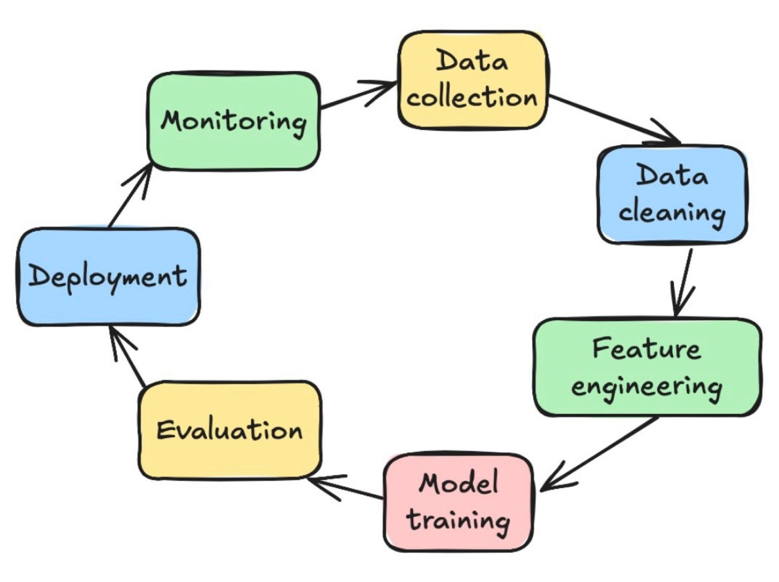
ML Lifecycle

Slide 12
Business Use Case & Success Criteria
  Define the problem clearly
  Set measurable goals for model performance
Data Extraction
  Collect relevant data from multiple sources
  Combine structured, unstructured, or streaming data
Data Analysis (EDA)
  Explore data distributions, missing values, correlations
  Understand features and relationships
  Identify preprocessing and feature engineering needs
Data Preparation & Feature Engineering
  Clean, normalize, and transform data
  Split data into training, validation, test sets
  Create new features or aggregate existing ones
Model Training
  Select algorithms and train multiple models
  Hyperparameter tuning for best performance
  Track training experiments
Model Evaluation & Validation
  Evaluate model on validation/test sets
  Use metrics aligned with business goals
  Confirm model readiness for deployment
Model Serving / Deployment
  Deploy as API, batch process, or embedded model
  Ensure production readiness and scalability
Model Monitoring & Feedback
  Track performance, detect drift or decay
  Trigger retraining cycles if needed
  Close the loop → feed new data back into lifecycle

Slide 13
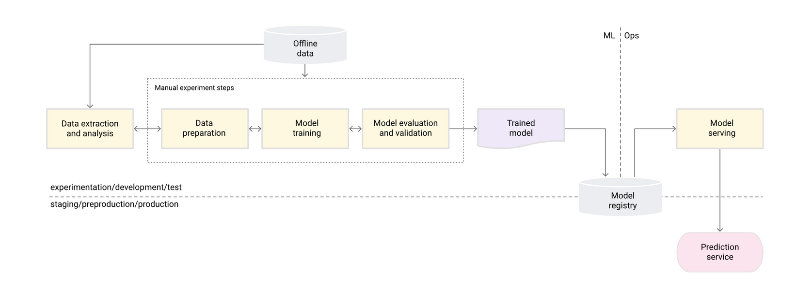
Levels of Automation

Slide 14
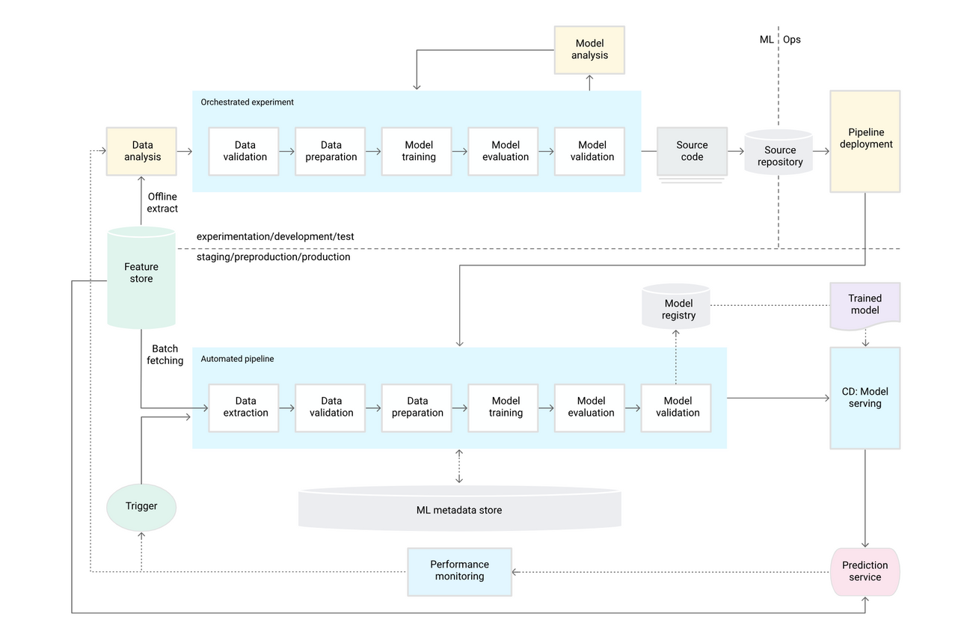
Levels of Automation

Slide 15
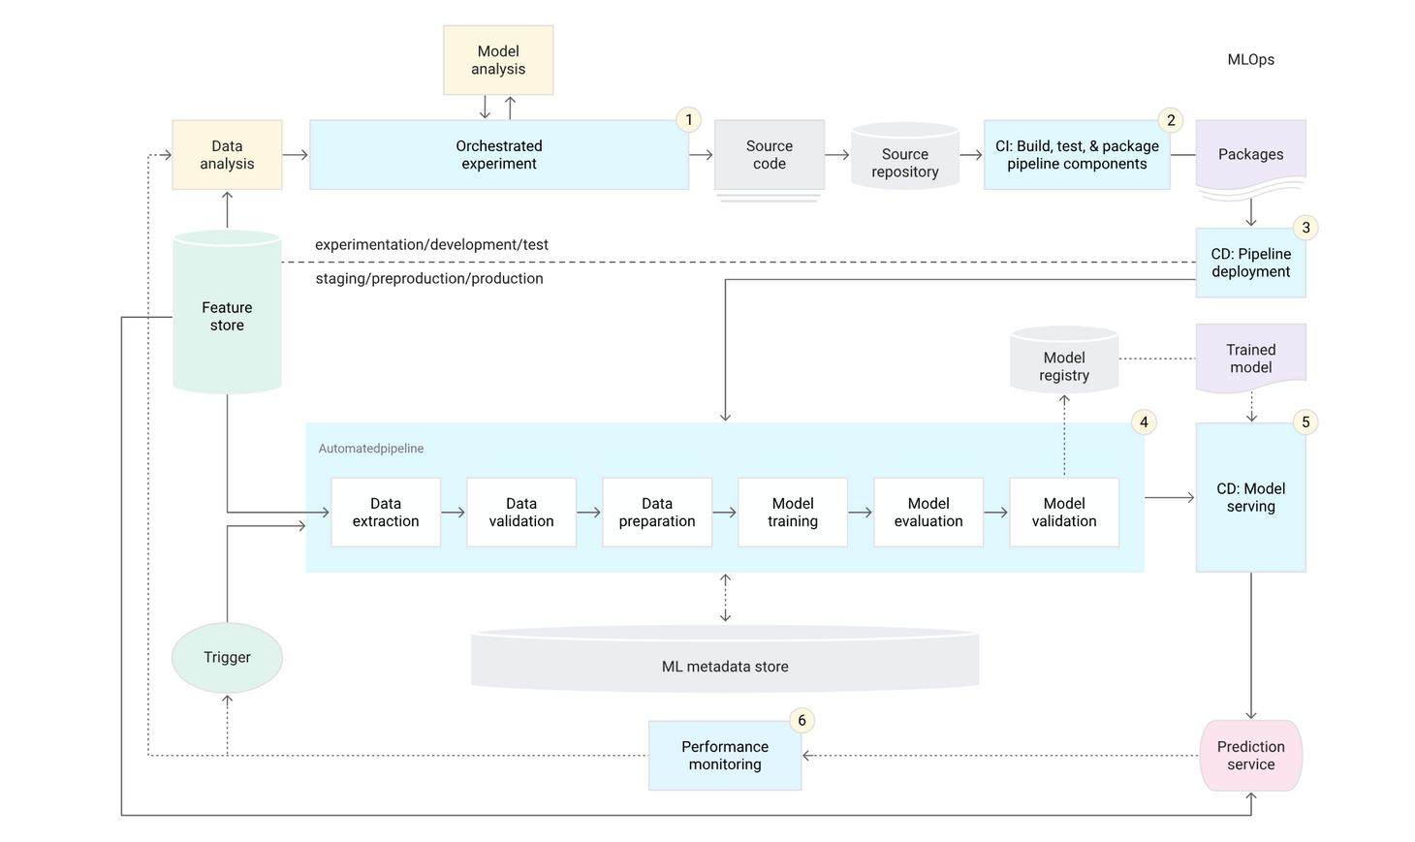
Levels of Automation

